Slide 1
Plasma Display, Liquid Crystal Display , Light Emitting Diode
Mr. Madhur Thapliyal
Assistant Professor
School of Computing
Department of Computer applications
Graphic Era Hill university

Slide 2
Flat Panel Display
The Flat-Panel display refers to a class of video devices that have reduced volume, weight and power requirement compare to CRT.
Example: Small T.V. monitor, calculator, pocket video games, laptop computers, an advertisement board in elevator.

Slide 3
Types
Emissive Display(Plasma Panels and LED)
Non Emissive Display(LCD)

Slide 4
1. Emissive Display: The emissive displays are devices that convert electrical energy into light. Examples are Plasma Panel, thin film electroluminescent display and LED (Light Emitting Diodes).
2. Non-Emissive Display: The Non-Emissive displays use optical effects to convert sunlight or light from some other source into graphics patterns. Examples are LCD (Liquid Crystal Device).

Slide 5
Plasma Panel Display
Plasma-Panels are also called as Gas-Discharge Display. It consists of an array of small lights. Lights are fluorescent in nature. The essential components of the plasma-panel display are:
Cathode: It consists of fine wires. It delivers negative voltage to gas cells. The voltage is released along with the negative axis.
Anode: It also consists of fine wires. It delivers positive voltage. The voltage is supplied along positive axis.
Fluorescent cells: It consists of small pockets of gas liquids when the voltage is applied to this liquid (neon gas) it emits light.
Glass Plates: These plates act as capacitors. The voltage will be applied, the cell will glow continuously.

Slide 6
The gas will slow when there is a significant voltage difference between horizontal and vertical wires. The voltage level is kept between 90 volts to 120 volts. Plasma level does not require refreshing. Erasing is done by reducing the voltage to 90 volts.
Each cell of plasma has two states, so cell is said to be stable. Displayable point in plasma panel is made by the crossing of the horizontal and vertical grid. The resolution of the plasma panel can be up to 512 * 512 pixels.

Slide 7
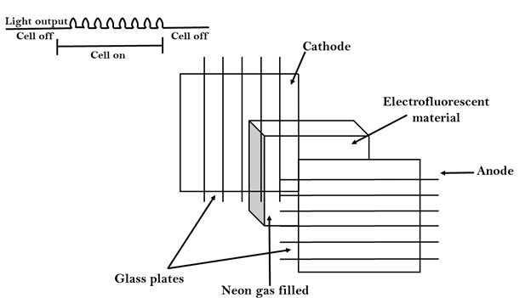

Slide 8
Advantages
Disadvantages
High Resolution
Large screen size is also possible.
Less Volume
Less weight
Flicker Free Display
Wiring requirement anode and the cathode is complex.
Its addressing is also complex.

Slide 9
Light Emitting Diode
In an LED, a matrix of diodes is organized to form the pixel positions in the display and picture definition is stored in a refresh buffer. Data is read from the refresh buffer and converted to voltage levels that are applied to the diodes to produce the light pattern in the display.

Slide 10
Liquid Crystal Display
Liquid Crystal Displays are the devices that produce a picture by passing polarized light from the surroundings or from an internal light source through a liquid-crystal material that transmits the light.
LCD uses the liquid-crystal material between two glass plates; each plate is the right angle to each other between plates liquid is filled. One glass plate consists of rows of conductors arranged in vertical direction. Another glass plate is consisting of a row of conductors arranged in horizontal direction. The pixel position is determined by the intersection of the vertical & horizontal conductor. This position is an active part of the screen.
Liquid crystal display is temperature dependent. It is between zero to seventy degree Celsius. It is flat and requires very little power to operate.

Slide 11
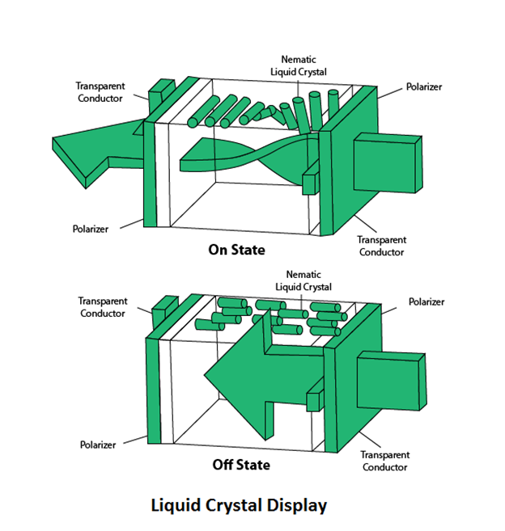

Slide 12
Thank You

